Slide 1
Engineering Materials

Slide 2
Materials Science and Engineering
Materials Science and Engineering
Composition means the chemical make-up of a material.
Structure means a description of the arrangements of atoms or ions in a material.
Synthesis is the process by which materials are made from naturally occurring or other chemicals.
Processing means different ways for shaping materials into useful components or changing their properties.

Slide 3
  In most eng. application, selection of metal is usually based on the following considerations:
    Product shape: a) sheet, strip, plate, (b) bar, rod, wire, (c) tubes, (d) forging (e) casting
    Mechanical properties-tensile, fatigue, hardness, creep,impact test
    Physical & chemical properties-specific gravity, thermal & electrical conductivity, thermal expansion
    Metallurgical consideration-anisotrophy of properties, hardenability of steel, grain size & consistency of properties
    Processing castability-castability, formability, machinability
    Sales appeal-color, luster
    Cost & availability

Slide 4
  Load carrying capacity of component can be related to the yield strength, fatigue strength or creep strength depending on loading & service condition.
    Strength characteristics are structure sensitive.
    Changed by changing chemical composition of the alloy, method and condition of manufacturing, as well as heat treatment
    Increasing the strength cause metal ductility & toughness to decrease which affects the performance of component.

Slide 5
  Electrical & thermal conductivities
    Thermal conductivity, K
      Is measure of the rate at which heat is transferred through a material
    Al & Cu- Manufacture of component where electrical conductivity is primary requirement
  Corrosion resistance & specific gravity limits the materials.

Slide 6
  Weldability – a function of material composition. So structure involve welding of the components need to consider. Also for other joining means.
  Machinability:
    Important if large amounts of material have to be removed
    improvement by heat treatment or alloying elements
  Economic aspects:
    material able to perform function at lowest cost
    Plain carbon steel & cast iron are the least expensive

Slide 7
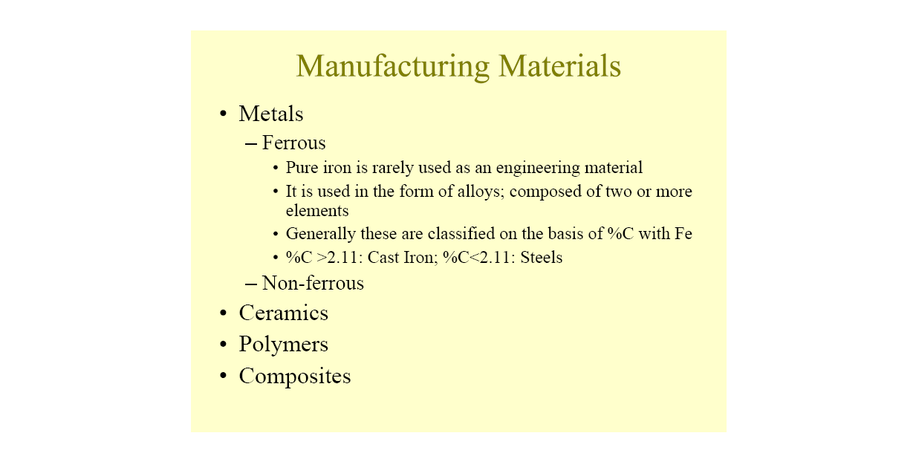
Classification of Engineering Materials

Slide 8
Table 1 Representative examples, applications, and properties for each category of materials
Example of Applications Properties
Metals and Alloys
Gray cast iron Automobile engine blocks Castable, machinable, vibration damping
Ceramics and
Glasses
SiO₂-Na₂O-CaO Window glass Optically transparent, thermally insulating
Polymers
Polyethylene Food packaging Easily formed into thin, flexible, airtight film

Slide 9
Table 1 Continued
Example of Applications Properties
Semiconductors
Silicon Transistors and integrated Unique electrical
circuits behavior
Composites Carbide cutting tools for High hardness, yet Tungsten carbide machining good shock resistance
-cobalt (WC-Co)

Slide 10
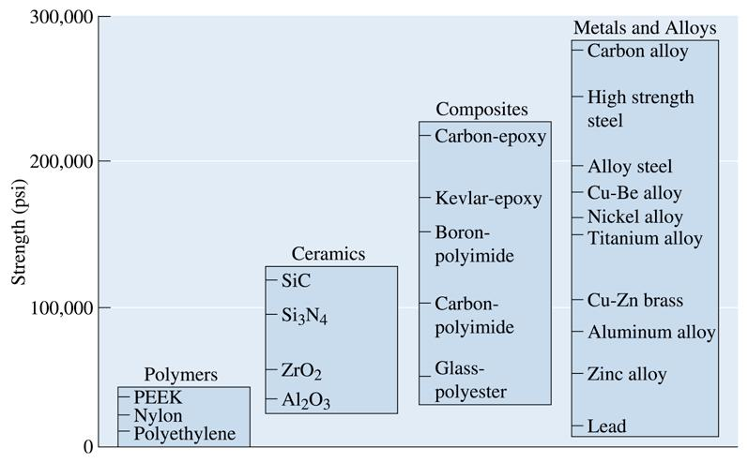
© 2003 Brooks/Cole Publishing / Thomson Learning™
Figure : Representative strengths of various categories of materials

Slide 11
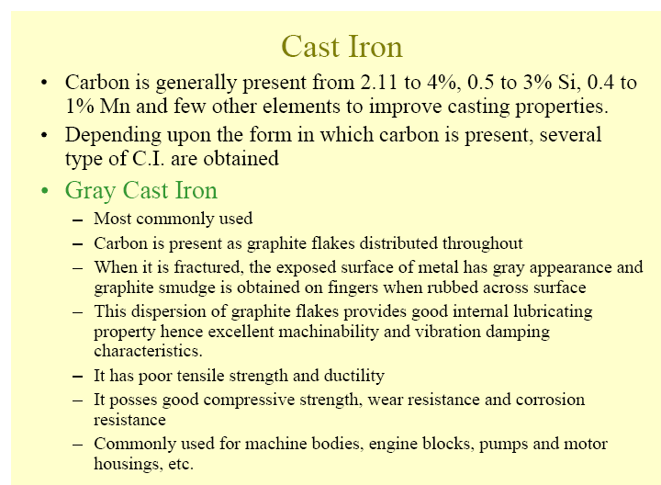

Slide 12
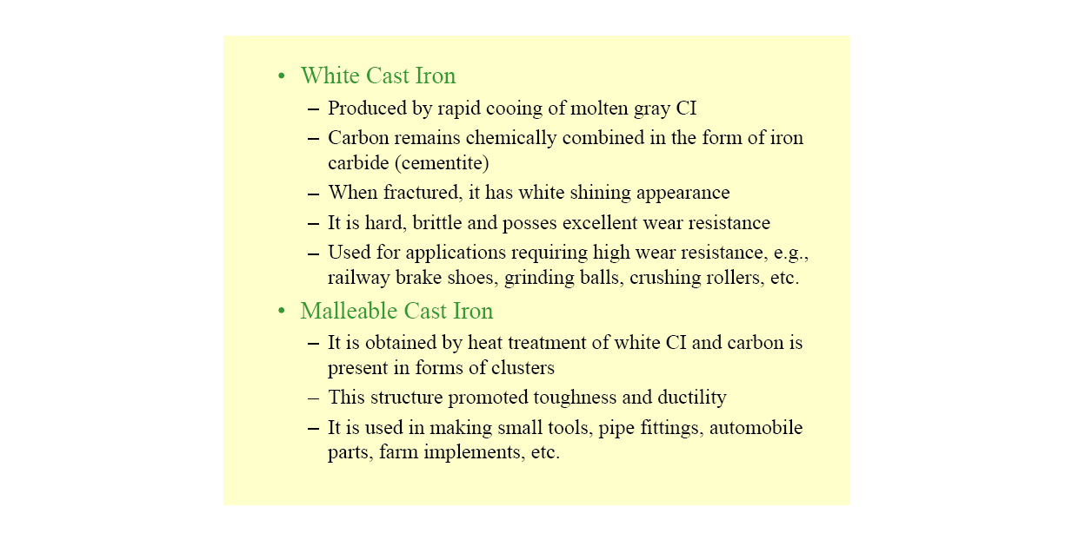

Slide 13
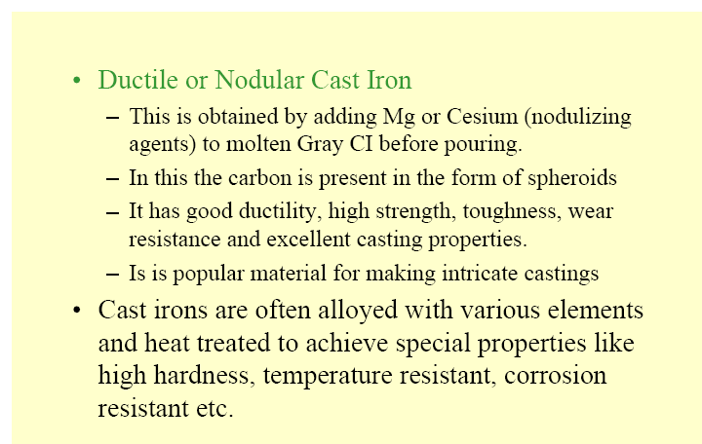

Slide 14
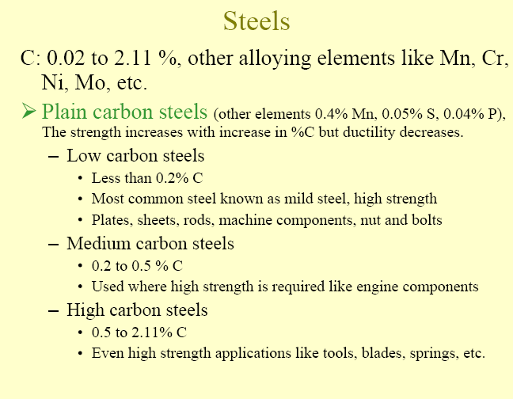

Slide 15
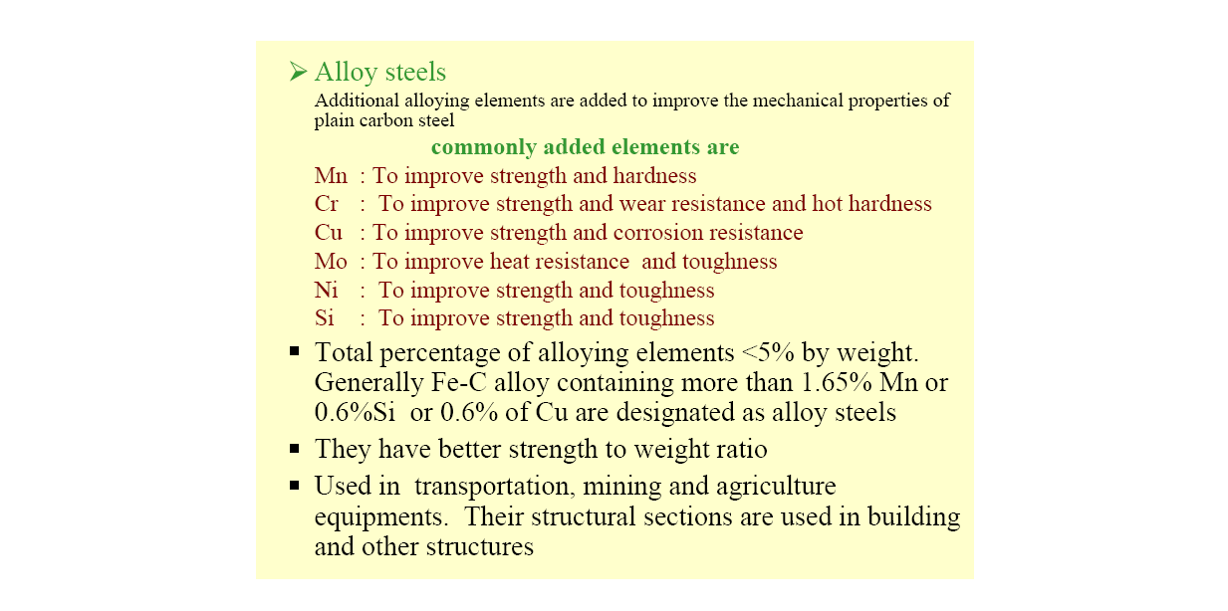

Slide 16
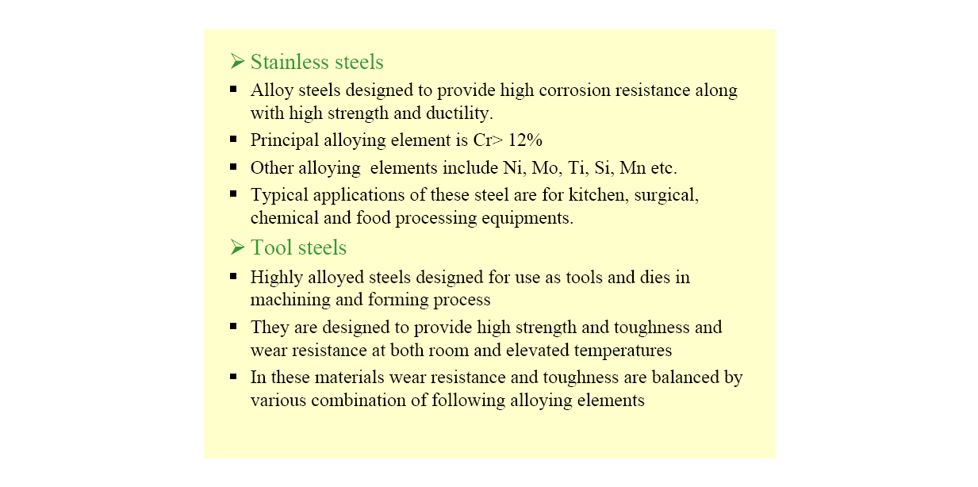

Slide 17
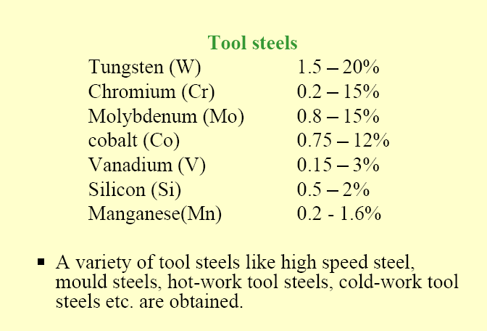

Slide 18
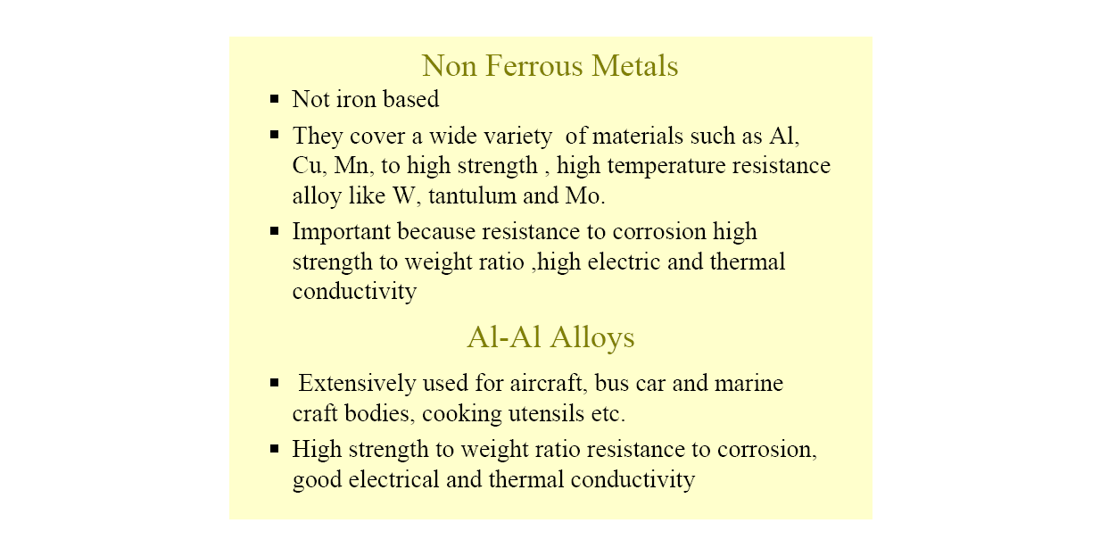

Slide 19
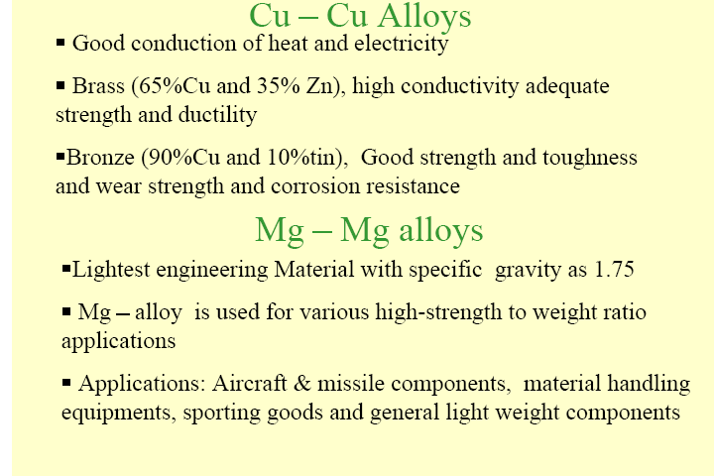

Slide 20
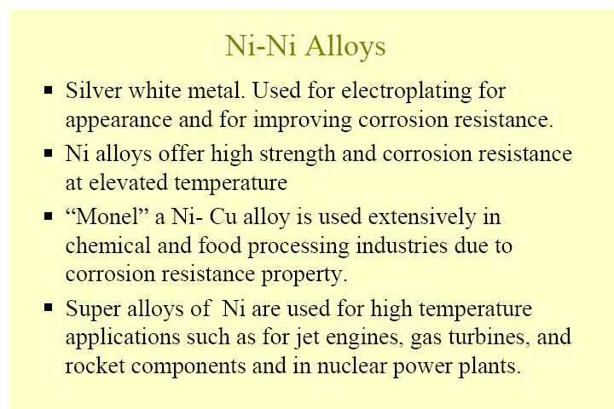

Slide 21
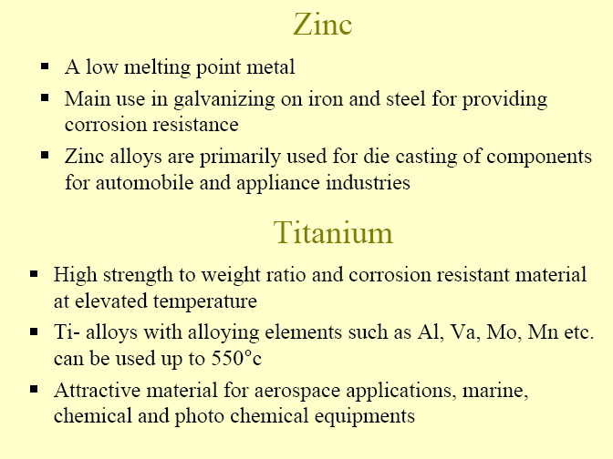

Slide 22
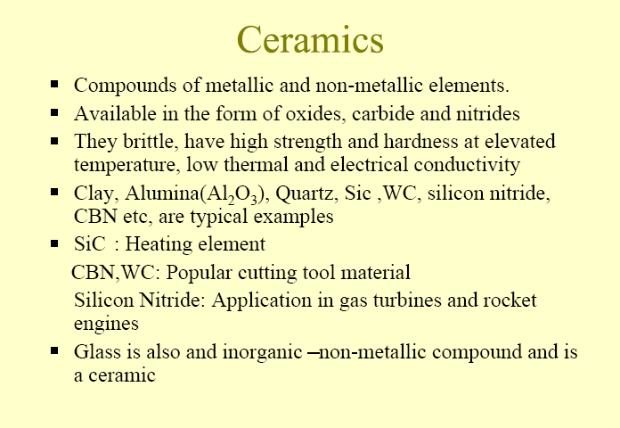

Slide 23
Ceramics – inorganic compounds of one or more metals with a nonmetallic element. Eg Al₂O₃, SiC, Si₂N₃.
  Crystal structure of ceramic are complex
    They accommodate more than one element of widely different atomic size.
  The interatomic forces generally alternate between ionic & covalent which leave few free electrons
    usually heat & electrical insulators.
  Strong ionic & covalent bonds give high hardness, stiffness & stability (thermal & hostile env.).

Slide 24
  Structure:
  (1) Amorphous or glass-short range order, (2) crystalline (long range order) & (3) crystalline material bonded by glassy matrix.
  Clasiification:
    Whitewares, glass, refractories, structural clay products & enamels.
  Characteristics:
    Hard & brittleness,
    low mechanical & thermal shock
    High melting points
    Thermal conductivities between metal & polymer

Slide 25
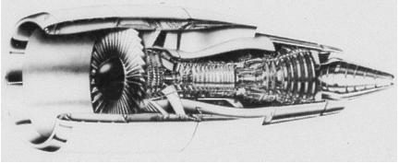
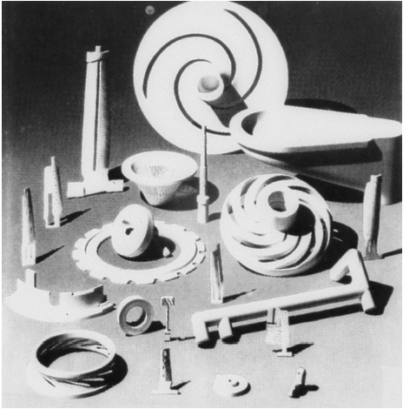
Figure :A section through a jet engine. The forward compression section operates at low to medium temperatures, and titanium parts are often used. The rear combustion section operates at high temperatures and nickel-based superalloys are required. The outside shell experiences low temperatures, and aluminum and composites are satisfactory. (Courtesy of GE Aircraft Engines.)
Figure : A variety of complex ceramic components, including impellers and blades, which allow turbine engines to operate more efficiently at higher temperatures. (Courtesy of Certech, Inc.)

Slide 26
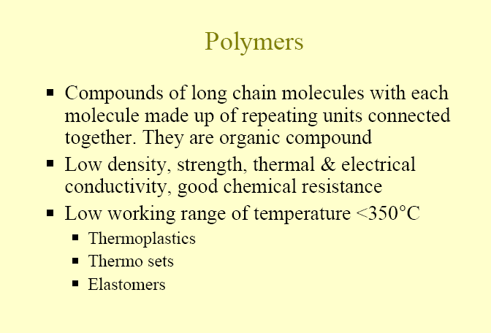

Slide 27
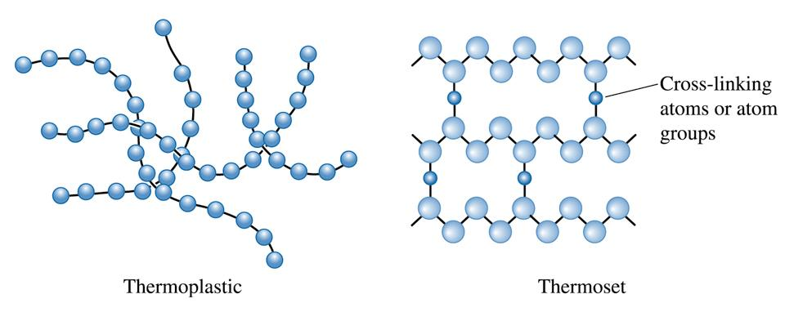
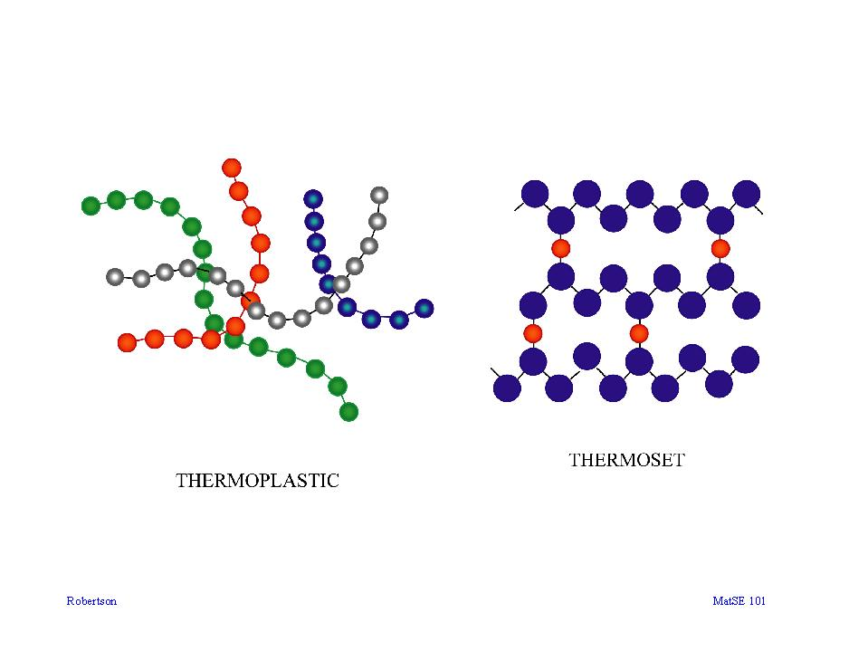
Two main types of polymers are thermosets and thermoplastics.
Thermosets are cross-linked polymers that form 3-D networks, hence are strong and rigid.
Thermoplastics are long-chain polymers that slide easily past one another when heated, hence, they tend to be easy to form, bend, and break.
Figure : Polymerization occurs when small molecules, represented by the circles, combine to produce larger molecules, or polymers. The polymer molecules can have a structure that consists of many chains that are entangled but not connected (thermoplastics) or can form three-dimensional networks in which chains are cross-linked (thermosets)

Slide 28
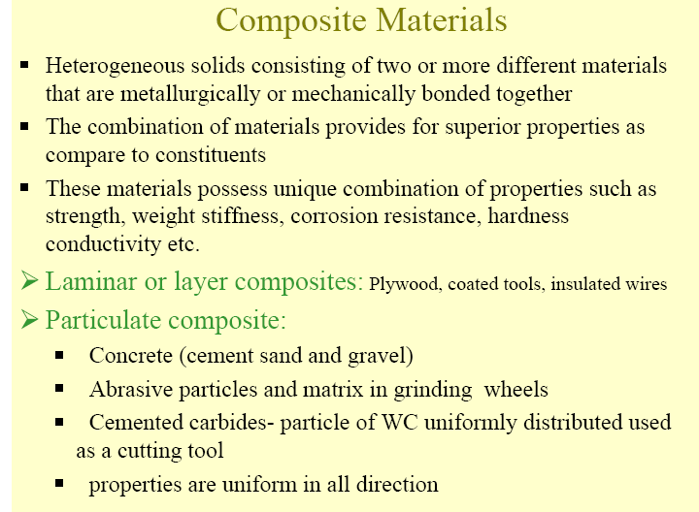

Slide 29
  A composite material can be broadly defined as an assembly two or more chemically distinct material, having distinct interface between them and acting to produce desired set of properties
    Composites – MMC, PMC & CMC.
    {Metal Matrix Composites (MMC). – Ceramic Matrix Composites (CMC). – Polymer Matrix Composites (PMC )}
  The composite constituent divided into two
    Matrix
    Structural constituent / reinforcement

Slide 30
  Properties / behavior depends on properties, size & distribution, volume fraction & shape of the constituents, & the nature and strength of bond between constituents.
  Mostly developed to improve mechanical properties i.e strength, stiffness, creep resistance & toughness.
  Three type of composite
    (1) Dispersion-strengthened,
    (2) Reinforcement – continuous & discontinuous
    (3) Laminated (consist more than 2 layers bonded together).

Slide 31
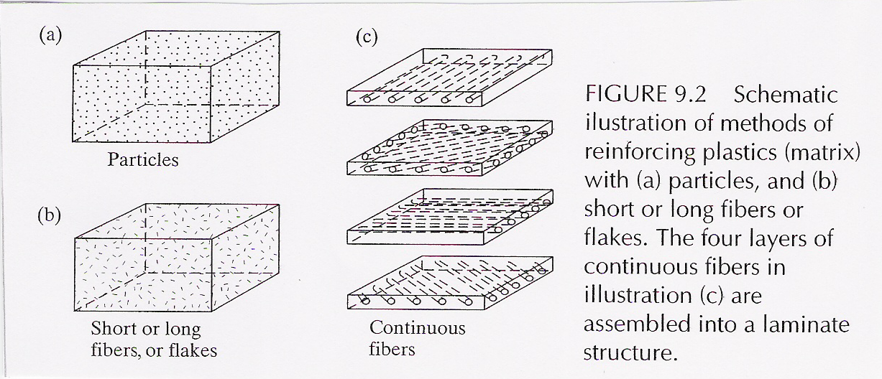

Slide 32
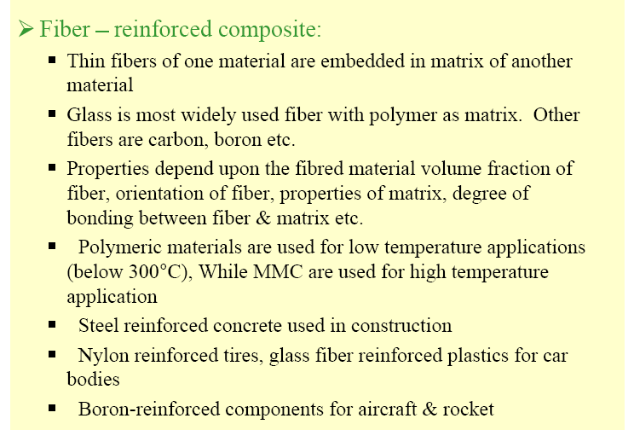

Slide 33
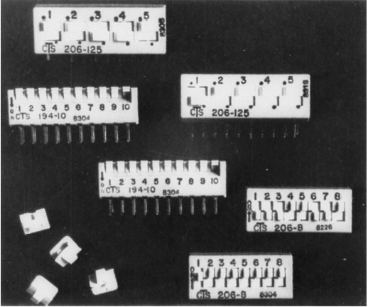
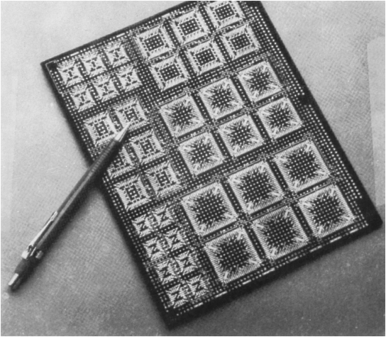
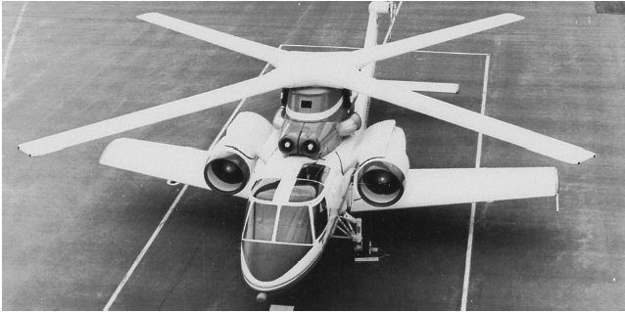
Figure :Polymers are used in a variety of electronic devices, including these computer dip
switches, where moisture resistance and low conductivity are required. (Courtesy of CTS Corporation.)
Figure :Integrated circuits for computers and other electronic devices rely on the unique electrical behavior of semiconducting materials. (Courtesy of Rogers Corporation.)
Figure :The X-wing for advanced helicopters relies on a material composed of a carbon-fiber-
reinforced polymer. (Courtesy of Sikorsky Aircraft Division—United Technologies
Corporation.)

Slide 34
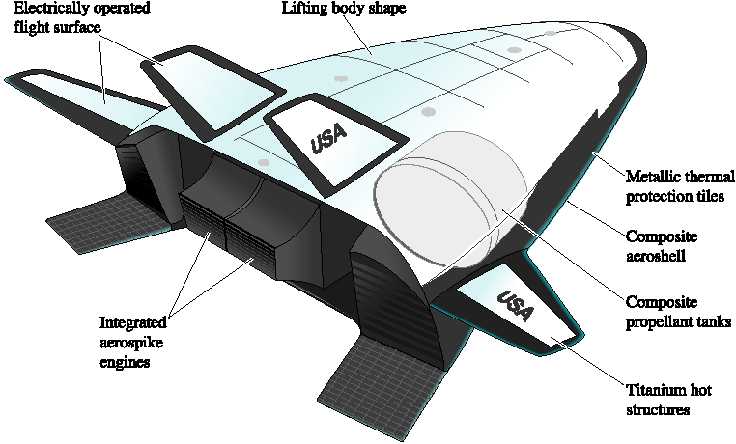
Figure : Schematic of a X-33 plane prototype. Notice the use of different materials for different parts. This type of vehicle will test several components. (From ‘‘A Simpler Ride into Space,’’ by T.K. Mattingly, October, 1997, Scientific American, p. 125. Copyright © 1997 Slim Films.)

Slide 35
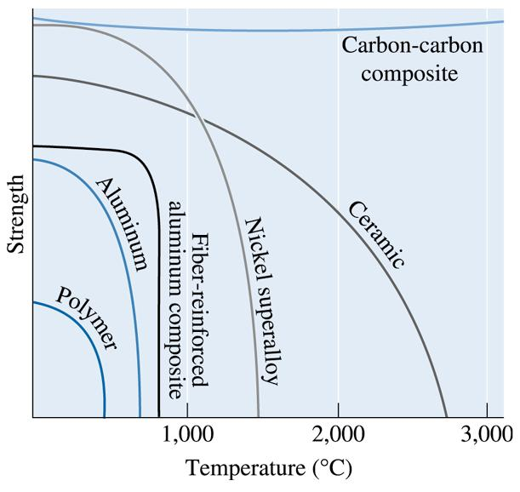
Figure : Increasing temperature normally reduces the strength of a material. Polymers are suitable only at low temperatures. Some composites, special alloys, and ceramics, have excellent properties at high temperatures

Slide 36
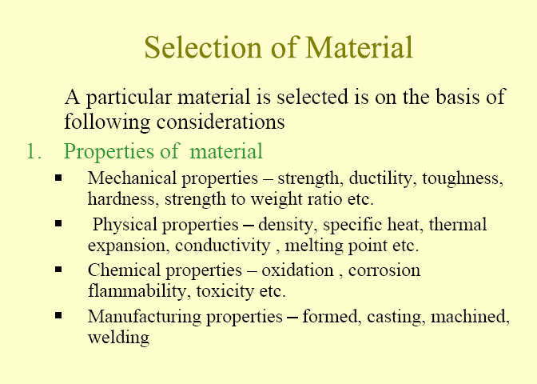

Slide 37
